Slide 1
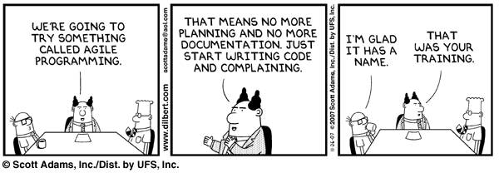

Slide 2
Structures + Functions
8/30/17
The Complete Reference C 4th edition
The Complete Reference C++ 4th Edition
Zybooks Chapter 6

Slide 3
Outline
Structures
Declaration
Definition
Accessing Members/Elements
Functions using Structures
Functions
Number/string conversions (If we have time)

Slide 4
Structures
A collection of variables referenced under one name
Keeps related information together
Tag – The identifier for the structure. (Think Variable Type)
Members – Variables within the structures (aka elements or fields)
Usually logically related to the tag and other members

Slide 5
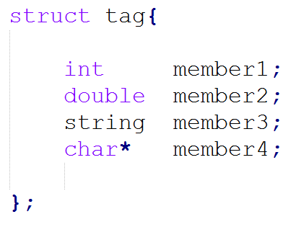
Structures
Declaration – defining an aggregate data type
Note: No variable has actually been created by the declaration
tag / name
Members
Elements
Fields
Mandatory semicolon

Slide 6


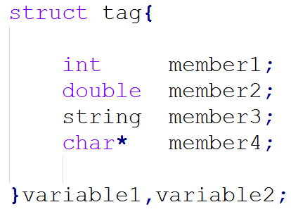
Structures
Variable declaration:
Traditional way:
At Structure Declaration:

Slide 7
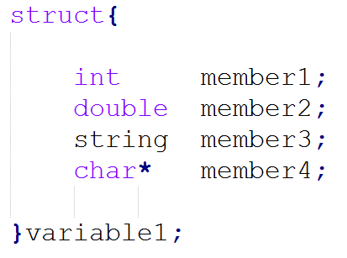
Structures
If you only need one structure variable, the tag is not required, but the variable before the semicolon is:

Slide 8
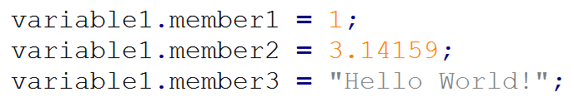
Structures
Accessing Structure Members – Dot Operator (.)
Be used to assign values to normal variables and normal variables can be used to assign value to members.

Slide 9

Structures
Arrays of structures:
Dot Operator (.) goes after the index when arrayed.

Slide 10

Structures
Examples:
Postal Address:

Slide 11
Structures
Examples: Postal Address
Structure tag: address, addr, …
Structure members:
name – string or char*
street – string or char*
city – string or char*
state – string or char*
country – string or char*
Zip Code – integer or unsigned int

Slide 12
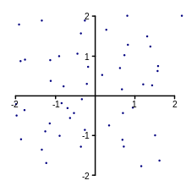
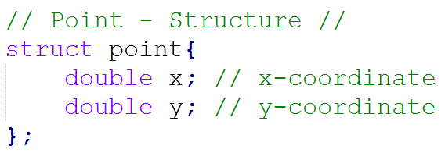
Structures
Example: Point

Slide 13
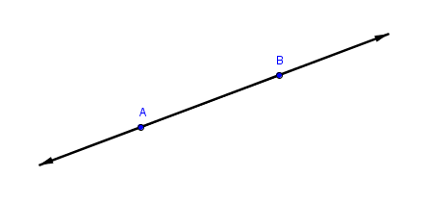
Structures
struct point{
double x;
double y;
};
struct Line{
point p1;
point p2;
};
...
Line trend;
trend.p1.x = 2;
trend.p1.y = 2;
trend.p2.x = 3;
trend.p2.y = 5;
Structures within Structures:
Example: Line

Slide 14



Structures
Declaring a Structure Pointer - * operator
Just like any other variable
Setting structure pointer

Slide 15
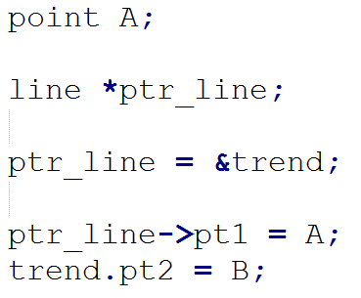
Structures
Accessing the member of a structure using pointers – arrow operator (->)

Slide 16
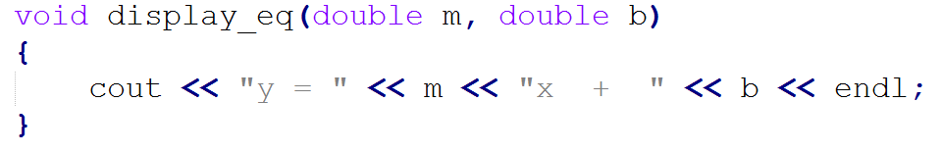
Structures
Passing Structure members to functions
When you pass a member of a structure, you are passing the value of that member to the function.

Slide 17

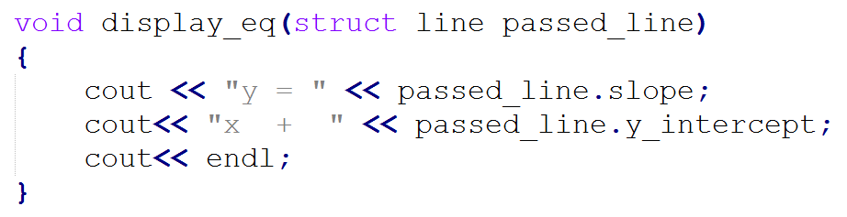
Structures
Passing Entire Structure Variables to functions
When a structure is used as an argument to a function, the entire structure is passed

Slide 18

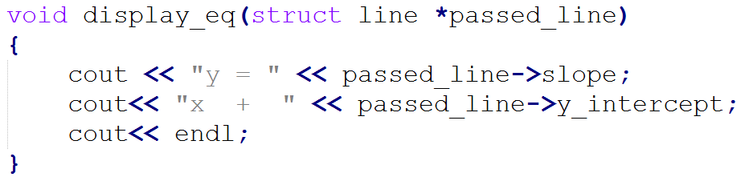
Structures
Passing Structure pointer to a function
When a structure pointer is used as an argument to a function, the structure address is passed

Slide 19
FUNCTIONS
Function – named list of statements
Function call – invoking function’s name
Function definition – function’s name + a list of statements surrounded by braces
Return – Causes the function to jump back to the original calling location with/without a value.

Slide 20
FUNCTIONS
Parameter – input to the function
void function( type parameter );
Argument – value passed to a parameter (can be a value or variable)
function( argument )

Slide 21
FUNCTIONS
Return
A function can only return one data type, structure, or void
The return type must match the function type
Ex:
int function() must return an integer
void function() must return (with no data type).

Slide 22

FUNCTIONS
Scope – how much of the program sees a variable or function
Typically sequential.
Bound by function boundaries.
Without Prototype, a function only has the scope of the code below that function.
Prototype – specifies the function’s return type, name, parameters, ending with a semicolon
Good Practice: Have Prototypes before main, have functions below main

Slide 23
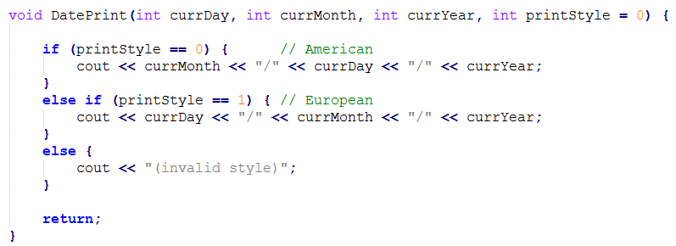
FUNCTIONS
Default parameter Types – way of making function parameters optional
Must be done for the last argument(s)

Slide 24
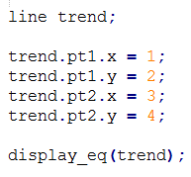
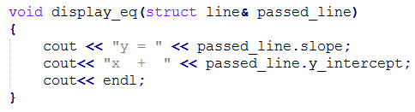
FUNCTIONS
Pass by reference – Does not create a local copy of the argument. Parameter refers directly to the argument variable memory location
Pass variable in argument – Have & in Parameter

Slide 25
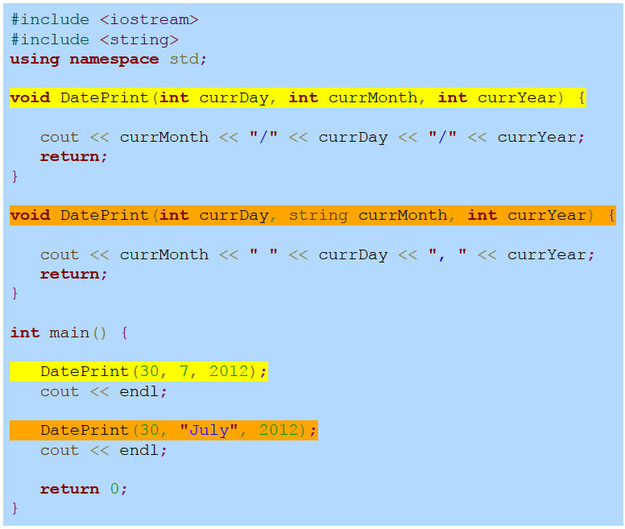
FUNCTIONS
Function Overloading – having two or more functions with the same name, but with differing parameters

Slide 26
FUNCTIONS
Function Overloading – having two or more functions with the same name, but with differing parameters
NOTE: The function return type does not influence overloading. Meaning having both:
double function1();
int function1();
Causes a compiler error.

Slide 27
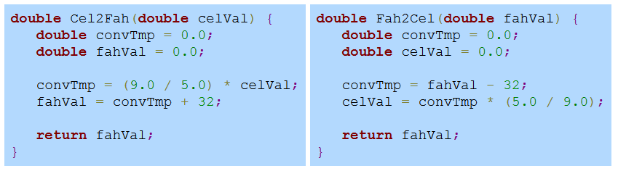
FUNCTIONS
Common Errors:
Copy-paste: Copying and Pasting code without fixing all the modifications that need to be made.

Slide 28
FUNCTIONS
Common Errors:
Copy-paste: Copying and Pasting code without fixing all the modifications that need to be made.

Slide 29
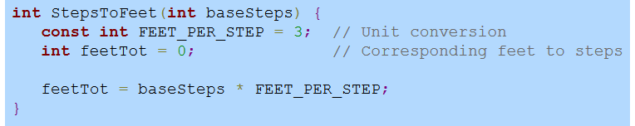
FUNCTIONS
Common Errors:
Copy-paste: Copying and Pasting code without fixing all the modifications that need to be made.
Returning the wrong variable: See example from (1)
Failure to return a value.

Slide 30
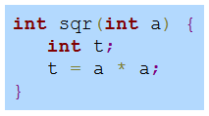
FUNCTIONS- Will it Work?
Troubleshooting: Is this function correct for squaring two integers?

Slide 31
FUNCTIONS- Will it Work?
Troubleshooting: Is this function correct for squaring two integers?
The Return Statement is Missing

Slide 32
FUNCTIONS
Separate files – Dividing the code between different .cpp files
Keeps the main file from getting out of hand
Separated files can be used in future programs

Slide 33
FUNCTIONS
Separate files – Dividing the code between different .cpp files
class.cpp
class.h
main.cpp
functions.cpp
functions.h

Slide 34
FUNCTIONS
Preprocessor – tool that scans the file for any lines that begin with #
Not a program statement but directs the preprocessor to modify the file in some way before compilation continues.
Most common seen: #include
#include “myfile.h” – look for the file in the same folder/directory as the including file
#include<iostream> - look for the file in the system’s standard library
C++ - libraries do not have .h.
C++ - C standard libraries have ‘c’ before the library name

Slide 35
FUNCTIONS
Examples if time:
Structure Example: Point and Line Structures.
Function Example: Function with Multiple Source Files

